Slide 1
CRBM September 2003
Using the MMDB C++ library from Python
Liz Potterton & Stuart McNicholas, CCP4

Slide 2
Background
CCP4 has traditionally developed and maintained programs for macromolecular crystallography – mostly in Fortran. We realised a need for object-oriented programming particularly to handle more complex experimental data. Hence the development of two C++ libraries:
Clipper, for experimental data, by Kevin Cowtan
MMDB (macro-molecular data-base) by Eugene Krissinel

Slide 3
CCP4mg
CCP4mg project begun after the library project.
We want to use the libraries and integrate with other scientific methods being developed in C++ but
recognise advantages of Python for rapid coding and the Python libraries (and thanks to Warren and Michel for demonstrating Python MG will work!).

Slide 4
SWIG
Auto generates code to export C/C++ interface to Python (and other scripting languages).
We had some problems initially – particularly exporting overloaded method names. These were solved by SWIG version >=1.3.17
Our build currently auto generates for all of MMDB – huge file and the slow step in program building. (Solution: we need to be more discerning in what we interface).

Slide 5
C++-Python Interface Issues
It is not efficient to pass large quantities of data through this interface. Any functionality which requires looping over all atoms (or residues) is written in C++. (Should we just export the whole data structure in one go?).
In our code Python does not access the underlying data – it is a puppet-master which usually deals with pointers to the model, handles to selection sets and a few individual atom/residue/chain pointers.

Slide 6
MMDB
MMDB is heavily used by European BioInfomatics Macromolecular Structure Database group to handle deposited data which may be in PDB or mmCIF format.
Freely available – www.ccp4.ac.uk
www.ebi.ac.uk/~keb/cldoc

Slide 7
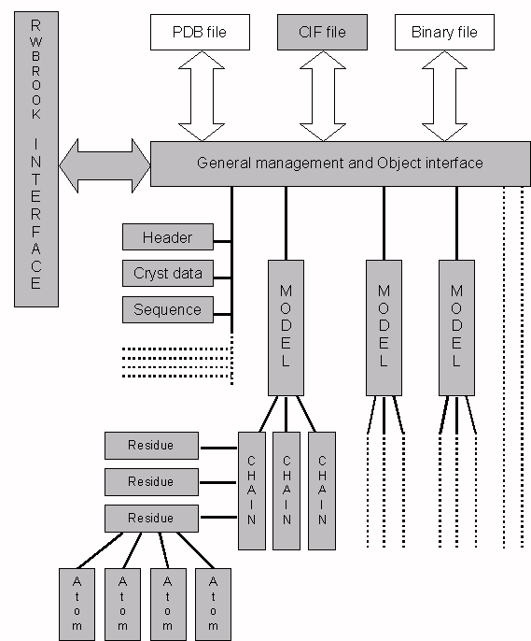

Slide 8
MMDB Functionality
Read/write PDB mmCif, binary format
Large number of methods to ‘surf’ data structure
Methods to safely edit the data structure
Tools to select sets of atoms (these are brilliant!)
Handling additional generic user defined data
Structure analysis methods

Slide 9
Python Code example – list chain ids and residue names
# molHnd is instance of MMDBManager object (a molecule)
molHnd = CMMDBManager()
#Read a PDB file
RC = molHnd.ReadCoordFile(‘mydata.pdb’)
# Get a table of the chains in the molecule
chainTable = newPPCChain()
nChains = intp()
molHnd.GetChainTable(1,chainTable,nChains)
#Loop over all chains and print chain ID
for ic in range(0,nChains.value())
pc=CChainPtr(getPCChain(chainTable,ic))
print ‘Chain’,pc.GetChainID()

Slide 10
#Get a table of the residues in the chain
resTable = newPPCResidue()
nRes = intp()
pc = GetResidueTable(resTable,nRes)
#Loop over residues and print out name and sequence ID
for ir in range(0,nRes.value())
pr = CResiduePtr(getPCResidue(resTable,ir))
print ‘ Residue’,pr.name,pr.seqNum
….and similarly for atoms

Slide 11
Comments on the Code Example
There are many means of navigating round the data hierarchy – the example shows just one of them
There are a few lines of code here to handle the C++-Python interface which presumably would not be necessary in a pure Python implementation.

Slide 12
Comments for CRBM
I may be going off on the wrong track but here’s my two pennies worth..
CCP4 is (mostly) writing scientific methods in C++ and not Python, so should we be involved in CRBM? One C in CCP4 is for ‘Collaborative’ so in principle we are interested.
The useful things people in CRBM might want to share are scientific methods but these are (usually) closely tied to underlying data structures which makes sharing tricky. (As a not completely reformed Fortran programmer I can not resist pointing out that this is at odds with the usual ‘reusable methods’ hype for OO).

Slide 13
Comments - continued
If I understood correctly one idea put up by Michel was some standardizing of interface to the underlying data structures.
Alternatively need mechanism to move data between different data structures. The old-fashioned way is via a file.

Slide 14
Comments - continued
Something I would like to see standardized – the naming syntax for atoms/residues etc.
e.g. MMDB/CCP4 syntax for unique identifier for an atom
/1/A/27/CA
i.e. CA atom or residue 27 or chain A of (NMR) model 1)
The NMR model number is usually omitted.

